Slide 1
15-213 Recitation: Final Exam Review
April 27, 2015
Arjun Hans, Felipe Vargas

Slide 2
Agenda
Proxy Lab
Final Exam Details
Course Review
Practice Problems

Slide 3

Proxy Lab

Slide 4

… is due tomorrow!
Due Tuesday, April 28th
Penalty late days allowed…
… but no grace days. Please finish on time!!!
Reminder: we will test your proxy manually
http://www.cs.cmu.edu/~213/index.html
http://csapp.cs.cmu.edu
http://www.cmu.edu
http://www.amazon.com
We will read your code
Correctness issues (race conditions, robustness, etc)
Style points: make your code shine! (write clean, well-documented, well-modularized code

Slide 5

Final Exam Details

Slide 6
Final Exam Details
Mon May 4th to Fri May 8th
Sign-ups will open soon!
10 problems, nominal time is 2-3 hours, but you get 6 hours!
Review session to take place in the near future! Stay tuned…
Cumulative: Chapters 1-3, 6-12
2 double-sided 8 1/2 x 11 sheets of notes
No pre-worked problems
Scratch paper will be provided

Slide 7

Course Review
Lol, not really

Slide 8
Course Review
Linking?!? … maybe
Integers/Floats
properties/arithmetic rules
Assembly
basic operators/memory addressing
control flow
procedures/stacks
arrays/structs
x86 vs x86-64
Memory Hierarchy
caches (address translation/implementation)
locality/cache friendly code
Exceptional Control Flow
exceptions
processes (syscalls, properties)
signals (handlers, masks, synchronization)

Slide 9
Course Review (con)
Virtual Memory
uses (caching, memory management/protection)
implementation (page tables, TLB)
address translation
dynamic memory allocation
File IO
syscalls (open, read/write, dup/dup2)
file-descriptor/file-entry tables
Rio package (buffered/unbuffered IO)
Networking
sockets API
networking terminology (protocols, DNS, LAN’s)
Synchronization
pthreads API
thread safety
scheduling problems (starvation, readers-writers, producers-consumers)
concurrency problems (deadlock, livelock)

Slide 10

Course Review
In-Depth
A long time ago, in a galaxy far, far way…

Slide 11
In-depth Review
Cover key-concepts from each chapter
Not in-depth; just things you should know/brush up on
Describe common test-questions
Not a guarantee; just an indication of what to expect
Outline tips/strategies to attack exam problems

Slide 12
Integers/Floats Concepts
Integers:
Arithmetic/encodings for signed/unsigned integers
Translation between decimal/binary/hexadecimal
Bitwise operations
Casting rules (sign/zero extension)
Floats:
Encoding rules (normalized/denormalized regions)
Calculations (bias, exponent/fractional values)
Special values (infinity, NaN)
Rounding (to even, generally)
Miscellaneous:
Endian-ness (big: most significant byte stored at lowest address, little: most significant byte stored at highest address)

Slide 13
Integers/Floats Exam Problems/Tips
Integers:
True/False for identities
Bit-representation of decimal values
Decimal value of expressions, given variable values
Floats:
Provide binary representation/rounded decimal value given encoding formats (no. exponent/fractional bits)
Tips:
For identities, try ‘extreme values’ (Int min/max, 0, -1, 1) to check for counter-examples
Write down values of min/max norm/denorm numbers given format parameters first (can then easily classify decimal values)
Know bit-patterns of key values (min/max norm/denorm values, infinity, NaN)

Slide 14
Assembly Concepts
Basics
Registers (%rax, %eax, %ax, %al; 64, 32, 16, 8 bits)
Arithmetic operations (op <dest> <src>, generally)
Memory addressing (immediates, registers;
eg Imm(E_{b} ,E_{i} ,s ) = M[Imm+R[E_{b}]+R[E_{i}].s] with mov, Imm+R[E_{b}]+R[E_{i}].s with leal)
Suffix indicates data-type (l: long, b: byte, s: short, etc)
Control Flow
cmp S1, S2 => S2 - S1, test S1, S2 => S1 & S2)
jumps: direct, indirect (switch statements), conditional (je, jne, etc)
identify if/else (comparison, goto)
identify loop constructs (translate into do-while loop, with init value/check outside loop, then update/check inside loop)
condition codes (zero, overflow, carry, signed flags)
Pointer Arithmetic
given T* a, a + i = a + i * sizeof(T) address
given T* a, *a reads/writes sizeof(T) bytes

Slide 15
Assembly Concepts (Arrays/Structs/Unions)
Arrays:
Contiguous array of bytes
T A[n]: allocate array of n * sizeof(T) bytes; a[i] is at address a + T * i
Nested arrays: T a[M][N]: M arrays of N elements each (M rows, N columns)
Structs:
Combination of heterogenous elements, occupying disjoint spaces in memory
Alignment: address multiple an element can be located on
Alignment rules of types (char: 1 byte, short: 2 bytes, ints: 4 bytes, etc)
Machine-dependent (Windows vs Linux, IA32 vs x86-64, etc)
Entire struct aligned to maximum alignment (for usage in arrays)
Unions:
Single object can be referred using multiple types
All elements share space in memory

Slide 16
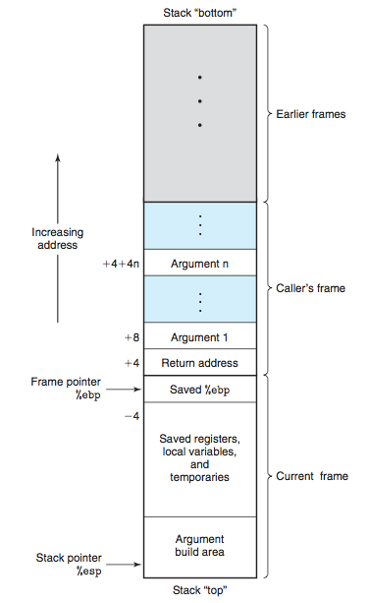
Assembly Concepts (Procedures/Stacks)
Key Instructions:
push S: R[%esp] <- R[%esp] - 4, S <- M[R[%esp]]
pop S: S <- M[R[%esp]], R[%esp] < R[%esp] + 4
call <proc>: push ret. addr, jump to proc instruction
leave: mov %esp, %ebp, pop %ebp
ret: pop %eip
Key Registers
%esp: stack-pointer (push/pop here)
%ebp: base-pointer (base of stack frame for procedure)
%eip: instruction pointer (address of next instruction)
Miscellaneous
Arguments pushed in reverse order, located in caller frame, above return address/saved %ebp
Caller vs Callee saved registers
Routines generally start with saving %ebp of calling function/end with restoring %ebp of calling function

Slide 17
Assembly Concepts (x86 vs x86-64, Miscellaneous)
Size Comparisons:
x86: 32-bits, x86-64: 64-bits (q: quad, 64-bits)
x86-64 Procedures
arguments passed via registers (order: %rdi, %rsi, %rdx, %rcx, %r8, %r9)
stack-frames usually have fixed size (move %rsp to required location at start of function)
base-pointer generally not needed (as stack-pointer is now fixed; can be used as reference point)
procedures generally don’t need stack-frame to store arguments (only when more arguments needed are they spilled onto the stack)
Miscellaneous:
special arithmetic operations (imull: R[%edx]:R[%eax] ← S × R[%eax], idivl: R[%edx] ← R[%edx]:R[%eax] mod S; R[%eax] ← R[%edx]:R[%eax] ÷ S)
conditional moves: move value into register, if appropriate flags set
buffer-overflow attacks: concept and defenses (stack-randomization/nop-sleds, canaries)

Slide 18
Assembly Problems/Tips
Assembly Translation
Annotations (how register values change, where jumps lead to) help
Know conditional/loop translation (determine the condition, identity of the iterator, etc)
Know where arguments are located (0x8(%ebp) onwards for x86, special registers for x86-64)
Identify ‘patterns’: set to zero: (xor %eax, %eax, shr $0x1f, %eax) check if zero: (test %esi, %esi) array-indexing (eg: (%edi, %ebx, 4): %edi + 4 * %ebx for accessing elem in integer array)
Stacks:
Know the diagram (location of args, base pointer, return address)
Go over buflab (locating the return-address/stack-pointer, writing content to the stack, etc)
Otherwise, relatively simple code-tracing
Struct Alignment:
Double-check the alignment of special types (usually provided in question; add them to your cheatsheet)
Minimize padding: place elements with maximum alignment constraints at start of struct (may still have to pad the struct itself, though)
Mapping assembly fragments to code-snippets for struct field access requires drawing the struct diagram, then determining offset of accessed field.

Slide 19
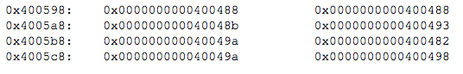
Assembly Problems/Tips
‘M & N’ Array Dimensions:
Derive expressions for array elements a[i][j] given dimensions
eg given array int arr[M][N],a[i][j] is at address (arr + 4 * (N * i + j))
Follow assembly trace to determine coefficients M/N
Switch Statements:
Look for this: jmpq *jtaddr (jump to address of jump table, plus some address offset, usually multiple of value we’re casing on).
Value at jump table address gives address of instruction to jump to
Determine which values map to the same set cases(‘fall-through’ behavior), default case
Jump Table
Jump Table
Addresses
Instruction Addresses

Slide 20
Memory Hierarchy
Principle:
Larger memories: slower, cheaper; Smaller memories: faster, more expensive
Smaller memories act as caches to larger memories
Locality:
Temporal: reference same data in the near future
Spatial: reference data around an accessed element
Cache Implementation:
<Tag bits><Set bits><Block Offset bits> indexing of address
Tag: uniquely identify an address in a set
Set: determine which set the line should go in
Block-offset: determine which byte in line to access
Valid bit: set when line is inserted for first time
Eviction policies (LRU, LFU, etc)
Cache Math:
m address bits (M = 2^m = size address space);
s sets bits (S = 2^s = no. sets)
b block-offset bits (B = 2^b = line size in bytes);
Miss Types
Cold: compulsory misses at start, cache is warming up
Capacity: not enough space to store full data set in cache
Conflict: access pattern leads to ‘thrashing’ of elements in cache (map to same cache lines)
t = m - (s + b) tag bits
E: no lines per set;
Cache Size = S * E * B

Slide 21
Memory Hierarchy Problems/Tips
Potential Questions:
Precisely analyze cache performance (no. hits/misses/evictions, access time penalty, etc)
Approximate cache performance (hit/miss rate)
Qualitatively analyze cache design principles (cache size, line size, set associativity, etc)
Tips:
Compute key quantities first (line size, no. sets, etc) from provided parameters
Mapping each address to a set/line is helpful (look for trends in the hit/miss patterns). Generally will need to write address in binary to extract values.
Row-major access has better cache performance than column-major access
Remember: we access the cache only on a miss. All the data on the same line as the element that caused the miss is loaded into the cache

Slide 22
Processes Concepts
Key Ideas:
Concurrent flow: execution is concurrent with other processes
Private address space: own local/global variables (own stack/heap)
Inherit values from parent (global values, file-descriptors, masks, handlers, etc).
Changes are then private to the process
Process can share state (eg file-table entries)
fork:
Creates a new process once, Called once, returns twice
0 returned to child, pid of child process returned to parent
execve:
loads/runs new program in context of process.
Called, once, never returns (except in case of error)
waitpid:
suspends calling process until process in wait-set terminates; reaps terminated child, returns its pid
+ve pid: wait set contains single child; -ve pid: wait set contains all children
options: return with 0 if none terminated, reap stopped processes, etc (see textbook)
status: can be examined with macros, return signal no. (see textbook)

Slide 23
Signals Concepts
Key Ideas:
message notifying process of some event; sent via the kernel
caught using a signal handler, else handled with default behavior (eg ignore, terminate program)
pending signals not queue’d (are blocked)
signal handlers can be interrupted by other signals
Kill:
send signal to process/process group
+ve pid: send to single process, -ve pid: send to process group with paid = abs(pid)
Masks:
bit-vector containing signals
manipulated using syscalls to empty/fill set, add/delete signals
set mask of calling process via sigprocmask (block, unblock, set); also can save old mask
sigsuspend: suspend process until signal not in provided mask received

Slide 24
ECF Problems/Tips
printf(“b”)
receive sigchld
Output Problems:
choose possible outputs/list all possible outputs
typically child is forked, multiple processes concurrently running
simple print statements, parent/child could modify variables, read/write to/from files, etc
Output Problem Tips:
Draw timeline indicating events occurring along each process’s trajectory, consider interleaving of execution
Note when a process is suspended, waiting for another process to terminate/send signal (using waitpid/sigsuspened)
Note when a process can receive a signal; consider what happens when signal handler is invoked at different points
sigchld blocked
printf(“a”)
sigchld unblocked
printf(“c”)
printf(“b”)
can’t print c before b
printf(“a”)
waitpid
printf(“c”)
x+=2 (now 7)
x = 5
x -= 2 (now 3)
parent/child have own view of memory

Slide 25
Virtual Memory Concepts
Virtual vs Physical Addresses:
Virtual addresses used by CPU, translated to physical addresses before sent to memory
Implementation:
Page Table: maps virtual addresses to physical addresses (addresses resident on pages). Mappings known as page-table entries
TLB: MMU requests TLB to check if the page-table entry present. If so, return the physical address; else, search in page table.
Page-fault: choose victim page, page contents to disk, insert new page/update PTE, reset the faulting instruction
Address Translation:
VPN: <TLB tag><TLB set>, VPN maps to PPN in page table
VPO and PPO are same for physical/virtual addresses (offset into page)
Physical Address: <PPN><PPO>, Virtual Address: <VPN><VPO>

Slide 26
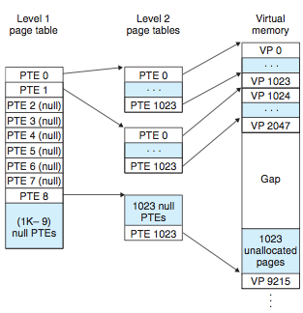
Virtual Memory Problems/Tips
Potential Questions:
Given virtual address/size of virtual/physical address spaces, check if physical address is stored in TLB/page table.
Outline operations performed in accessing page
Tips:
Understand the translation process (what happens in a page hit/fault)
Draw the binary-representation of the address first to extract the PN/PO and the TLB tag/set
Multi-level page tables: VPN is divided into VPN’s (generally equally sized) for each page-table (<VPN 1><VPN 2> … <VPN k>).
For i < k, VPN i is base address of PT. VPN k is address of VP

Slide 27
Dynamic Memory Allocation Concepts
Evaluation:
Throughput: no. requests/operations per unit time
Utilization: ratio of memory requested to memory allocated at peak
Fragmentation:
Internal: due to overheads (headers/footers/padding/etc)
External: due to access pattern
Design-Spaces:
Implicit Free-List: no pointers between free blocks, full heap traversal
Explicit Free-List: pointers between free-blocks, iterate over free blocks
Segregated Free-Lists: explicit-free lists of free-blocks based on size ranges
Search Heuristics:
First-Fit: return the first block found
Next-Fit: first-fit, maintains rover to last block searched, search starts at rover
Best-Fit: returns the block that best fits the requested block size
Coalescing Heuristic:
Immediate: coalesce whenever free’ing block/extending heap
Deferred: coalesce all free blocks only when free-block can’t be found
Free-block Insertion Heuristics:
LIFO: insert newly coalesced block at head of free-list
Address-Ordering: free-blocks are connected by ascending addresses

Slide 28
Dynamic Memory Allocation Problems/Tips
Potential Questions:
Simulate an allocator, given a set of heuristics (fill in the heap with values corresponding to header/footer/pointers)
Provide correct macro definitions to read/write parts of an allocated/free block, given specifications
Analyze an allocator qualitatively (impact of design decisions on performance) and quantitatively (compute util ratio, internal fragmentation, etc)
Tips:
Go over your malloc code/textbook code; understand your macros (casting, modularization, etc)
Go over block-size calculations (alignment/minimum block size)
Practice simple request pattern simulations with different heuristics

Slide 29
IO Concepts
Overview:
file-descriptor: keeps track of information about open file
Standard streams: stdin: 0, stdout: 1, stderr: 2
File-table is shared among all processes (each process has its own descriptor table)
Important Syscalls:
open(filename, flags, mode): open file using flags/mode, return fd
write(fd, buf, size): write up to ‘size’ characters in ‘buf’ to file
read(fd, buf, size): read up to ‘size’ characters from file into ‘buf'
dup(fd): return file-descriptor pointing to same location as fd
dup2(fd1, fd2): fd2 points to location of fd1
close(fd): close a file, restores descriptor to pool
Flags:
O_RDONLY: read-only, O_WRONLY: write-only
O_RDWR: read/write, O_CREAT: create empty file, if not present
O_TRUNC: truncate file, if present, O_APPEND: append to file

Slide 30
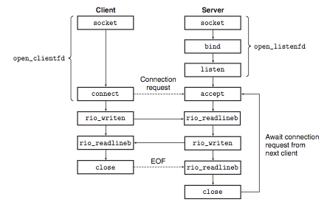
Networking Concepts
Sockets API:
socket: end-point for communication (modeled like a file in Unix)
Client: create socket, then connect to server (open_clientfd)
Server: create socket, bind socket to server address, listen for connection requests and return listening file-descriptor (open_listenfd),
Server accepts connection, return connected file-descriptor
Client/Server communicate via reading/writing from file-descriptors at end-points of channel

Slide 31
Networking Concepts (con)
Terminology
Networking Components: router, hub, bridge, LAN’s, etc
HTTP: HyperText Transfer Protocol, used to transfer hypertext
HyperText: text with references (hyperlinks) to other immediately accessible text
TCP: Transmission Control Protocol, provides reliable delivery of data packets (ordering, error-checking, etc)
IP: Internet Protocol, naming scheme (IPv4: 32 bits, IPv6: 128 bits)
DNS: Domain Naming System (domain names; use gethostbyaddr/gethostbyname/etc to retrieve DNS host entries)
URL: name/reference of a resource (eg http://www.example.org/wiki/Main_Page)
CGI: Common Gateway Interface (standard method to generate dynamic content on web-pages; interface between server/scripting programs)
Dynamic Content: construction is controlled by server-side scripts (using client inputs
Static Content: delivered to user exactly as stored

Slide 32
Synchronization Concepts
Threads:
logical flow in context of a process (can be multiple threads per process). Scheduled by kernel, identified by tid
own stack, share heap/globals
Pthreads API
pthread_create: run routine in context of new thread with args
pthread_join: block thread until specified thread terminates, reaps resources held by terminated thread
pthread_self: get tid of calling thread
pthread_detach: detaches joinable thread, thread can reap itself
Thread Un-safe Functions:
Class 1: do not protect shared variables
Class 2: preserve state across multiple invocations (str_tok, rand)
Class 3: return pointer to static variable (gethostbyname)
Class 4: call other thread-unsafe functions
Thread Safety:
Locking Primitives:
Scheduling Problems:
Concurrency Problems

Slide 33
Synchronization Concepts (con.)
Locking Primitives:
Semaphores: counter used to control access to resource (init with sem_init(sem_t *sem, 0, unsigned int value)
P(s): decrements s if s is > 0, else blocks thread (sem_wait)
V(s): increments s, chooses arbitrary thread to proceed if multiple threads blocked at P (sem_post)
Mutexes: binary semaphores (0/1 value)
Concurrency Problems:
Deadlock: no threads can make progress (circular dependency, resources can’t be released). e.g. thread 1 has A, waiting for B; thread 2 has B, waiting for A)
Livelock: thread constantly change wrt each other, but neither makes progress (eg both threads detect deadlock, actions mirror each other exactly)

Slide 34
Synchronization Concepts (con.)
Starvation:
some threads never get serviced (eg unfair scheduling, priority inversion, etc). Consequence of readers-writers solution
Consumers-Producers:
shared a bounded buffer with n slots
producer adds items to buffer, if empty spaces present
consumer removes items from buffer, if items present
implementation: semaphores to keep track of no. slots available/no. items in buffer, mutex to add/remove item from buffer
Readers-Writers:
multiple readers can access resource at a time
only one writer can access resource at a time
policies: favor readers/favor writers. Either may lead to starvation
implementation (favor readers): keep track of no. readers; first reader prevents writers from proceeding, last reader allows writers to proceed

Slide 35
Synchronization Problems/Tips
Potential Questions:
Is there a race on a value?
Add locking primitives to solve variants of readers/writers, producers/consumers problems
Identify/fix thread-unsafe function
Tips:
Draw diagrams to determine thread execution ordering (similar to processes); determine shared resources
Copying values to malloc’d memory blocks usually solves problems of resource sharing
Sharing globals/addresses of stack-allocated variables among threads requires synchronization (pthread_join, locking)
Acquire/release locks in reverse order (acquire A,B; release B, A); ensure that locks are released at end of all execution paths
Understand textbook solutions to readers/writers, producers/consumers problems (need/ordering of locks, usage of counters)

Slide 36

Practice Problems
Should NOT be you on the final!

Slide 37
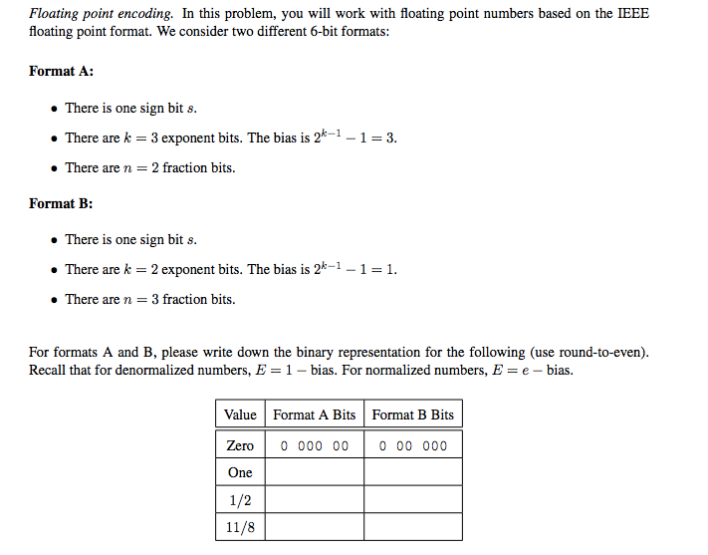
Floating Point

Slide 38
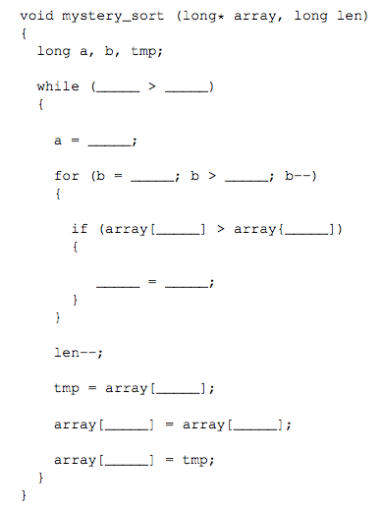
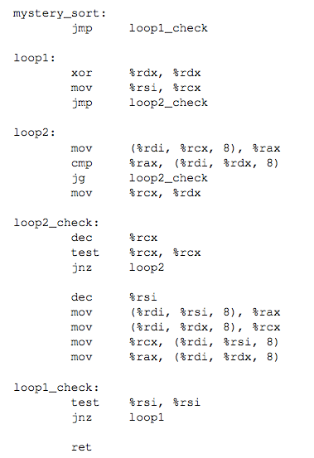
Assembly Translation

Slide 39
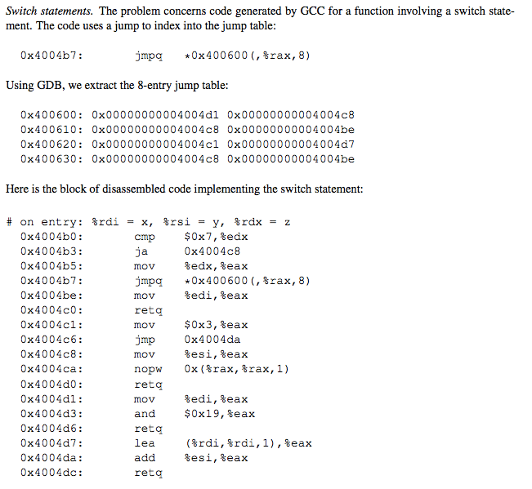
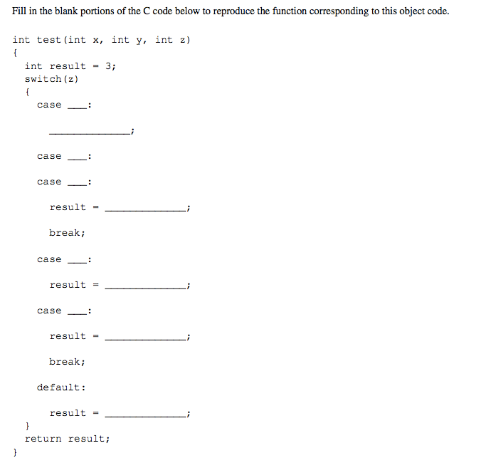
Switch Statement

Slide 40
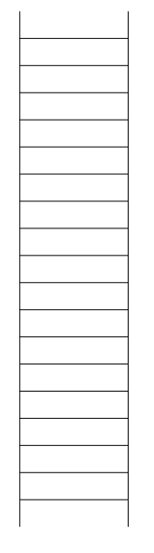
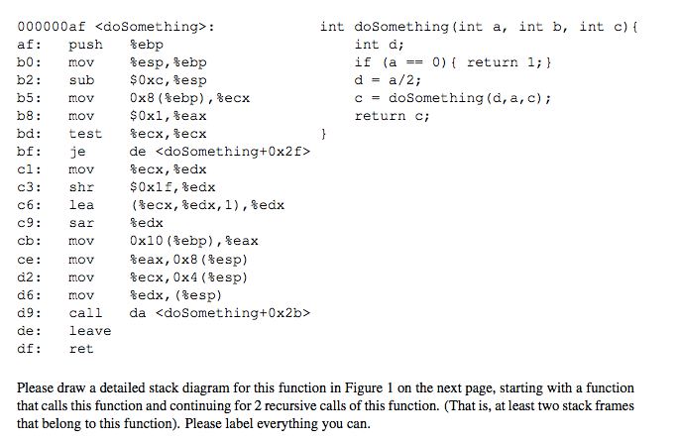
Stacks

Slide 41
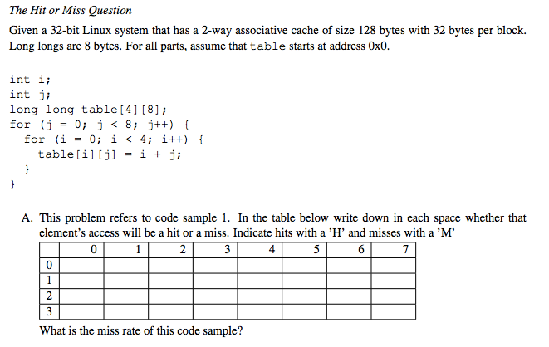
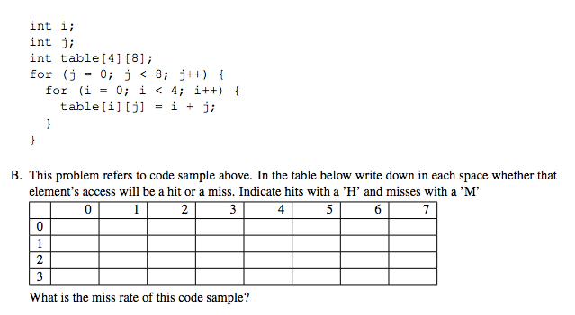
Caches

Slide 42
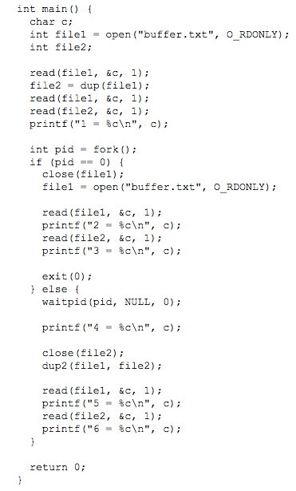
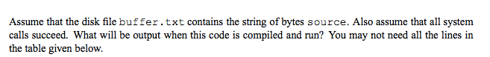
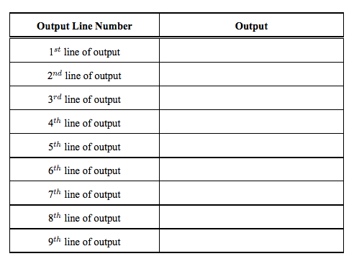
Processes/IO

Slide 43
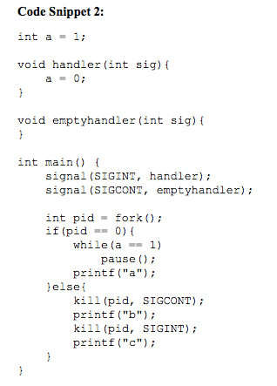
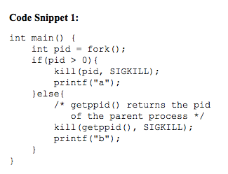
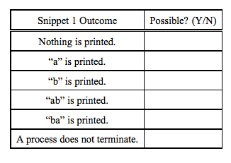
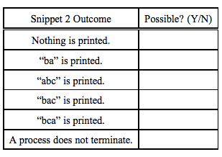
Signals

Slide 44
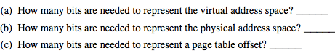
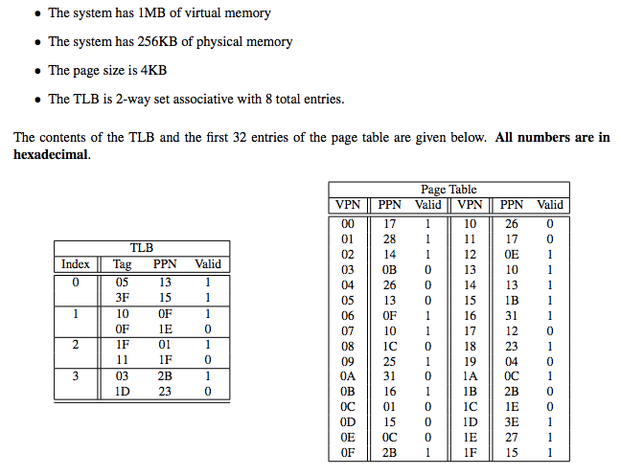
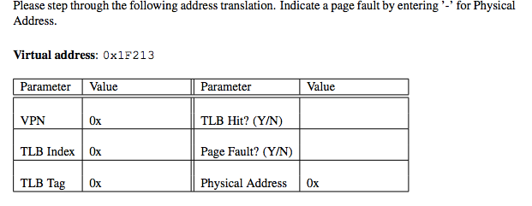
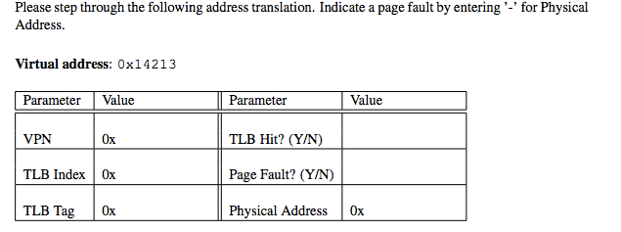
Virtual Memory

Slide 45
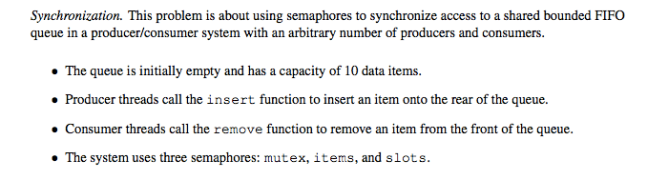
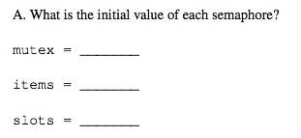
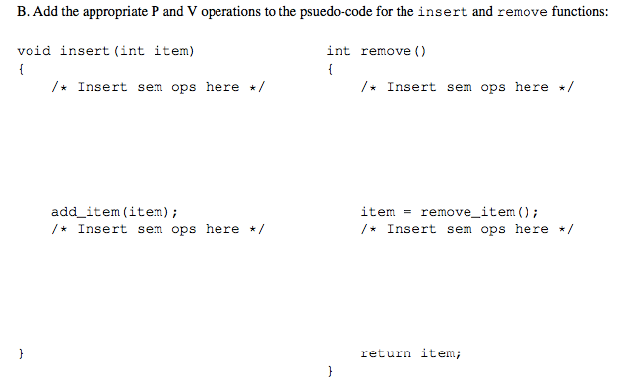
Synchronization

Slide 46
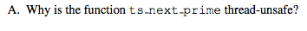
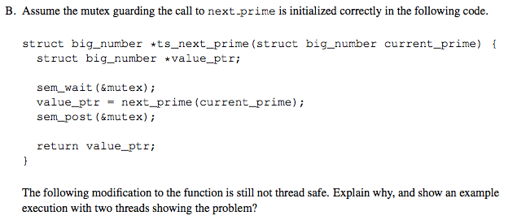
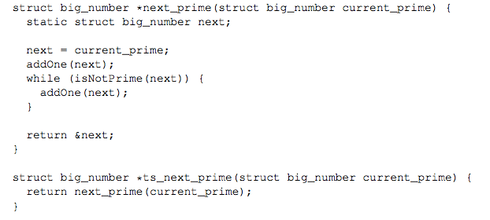
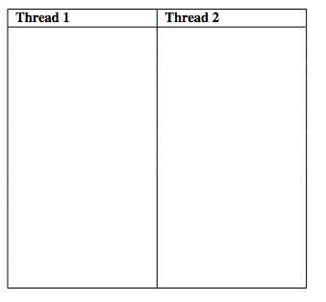
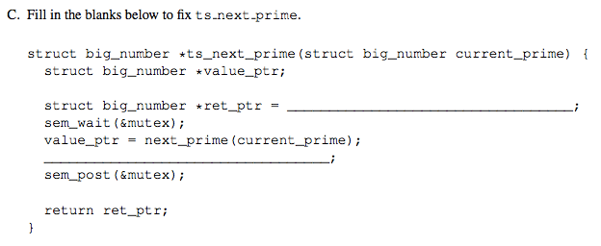
Thread Safety

Slide 47

Answers
Apologies for Arjun’s handwriting. :(

Slide 48
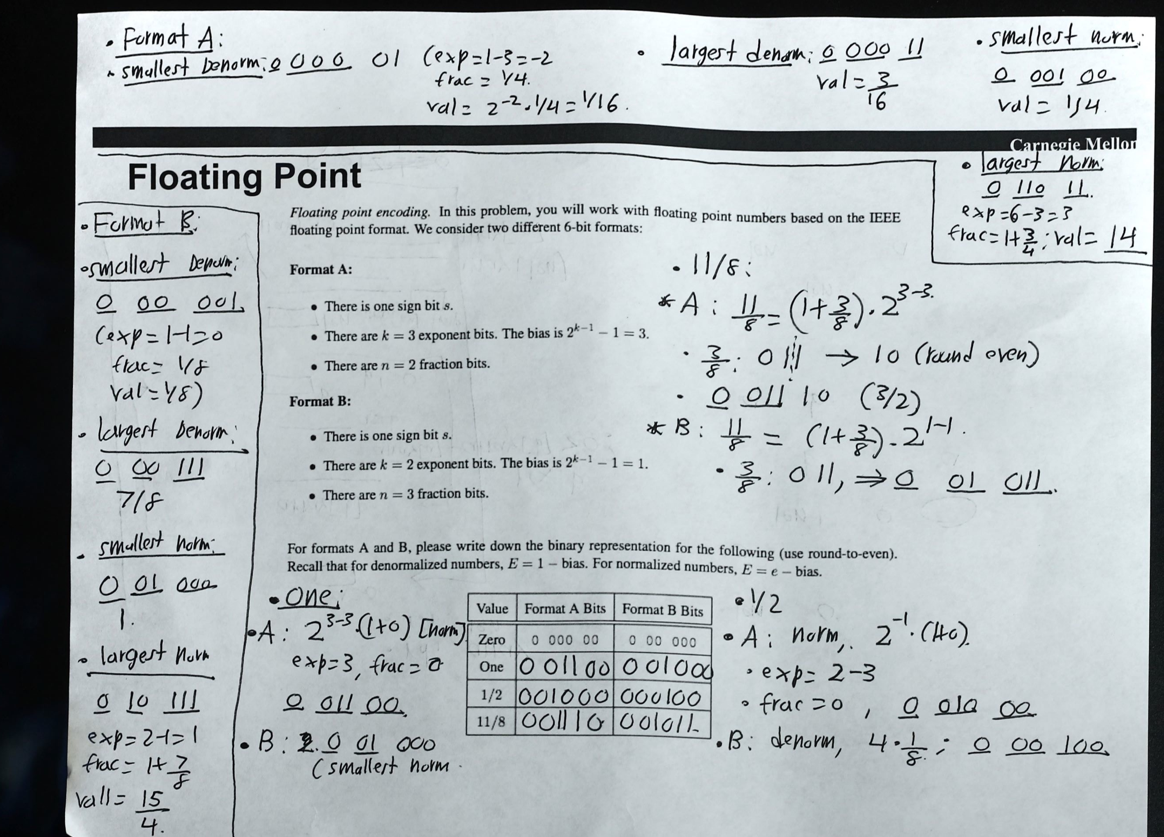

Slide 49
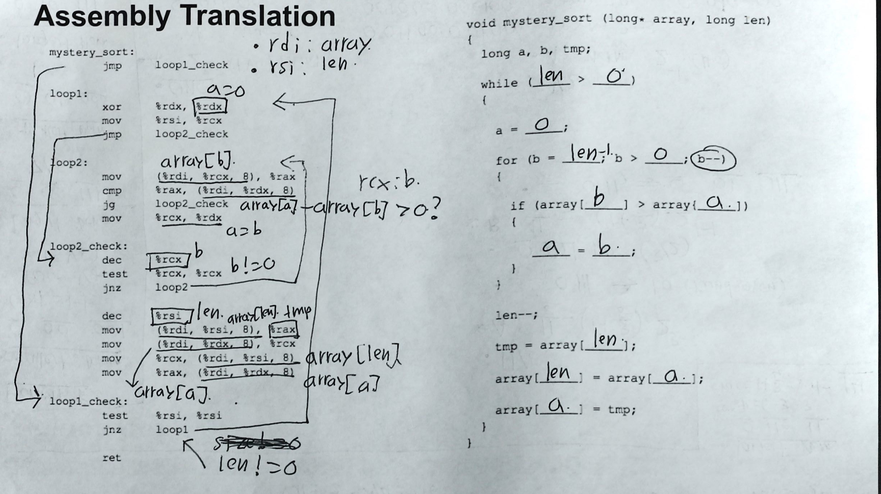

Slide 50
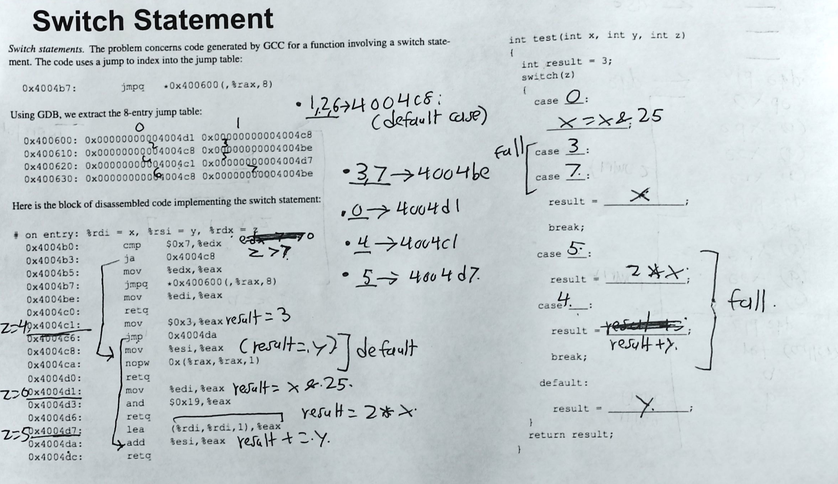

Slide 51
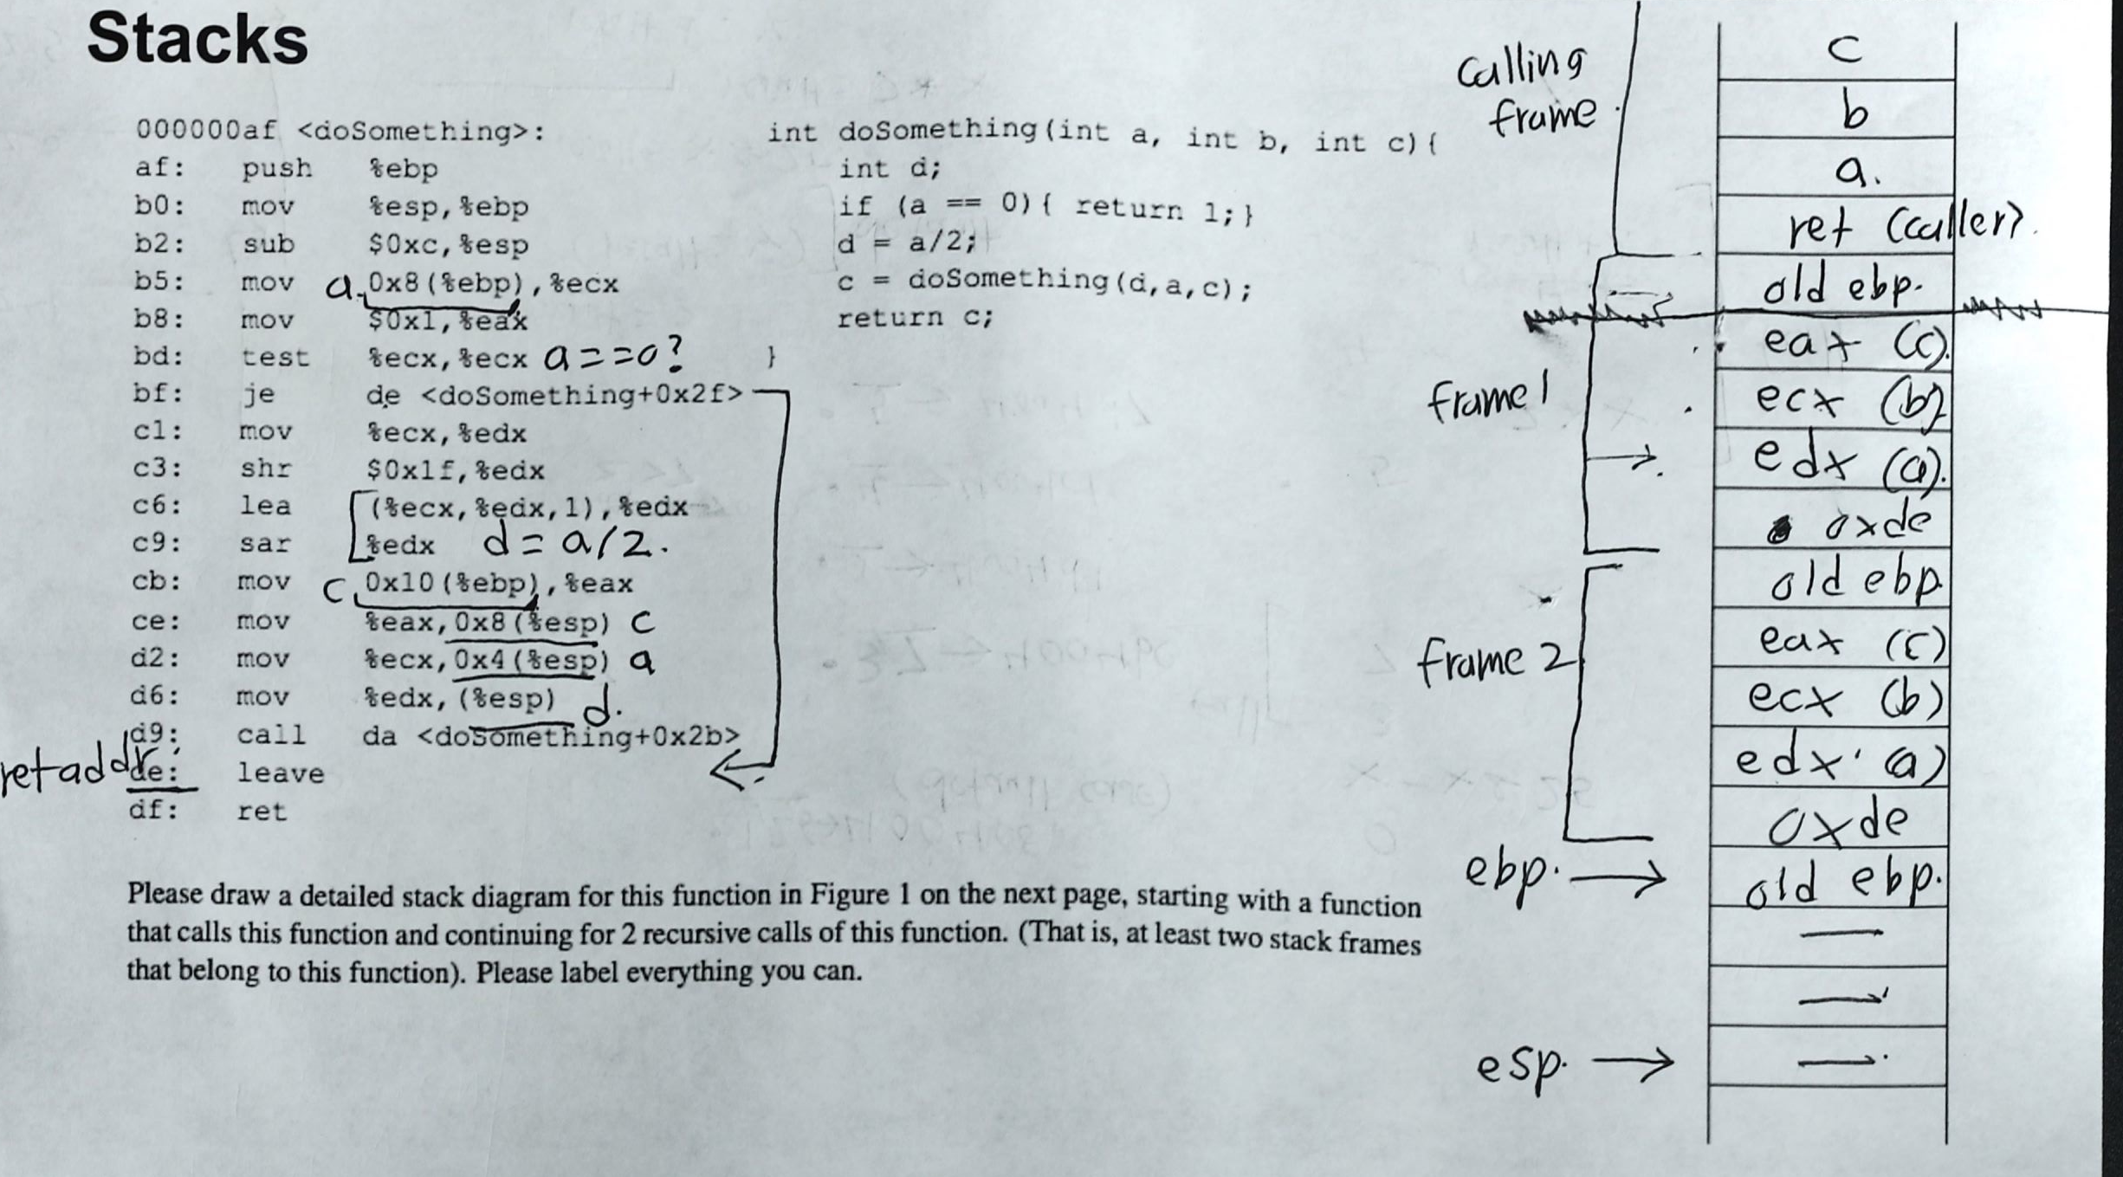

Slide 52
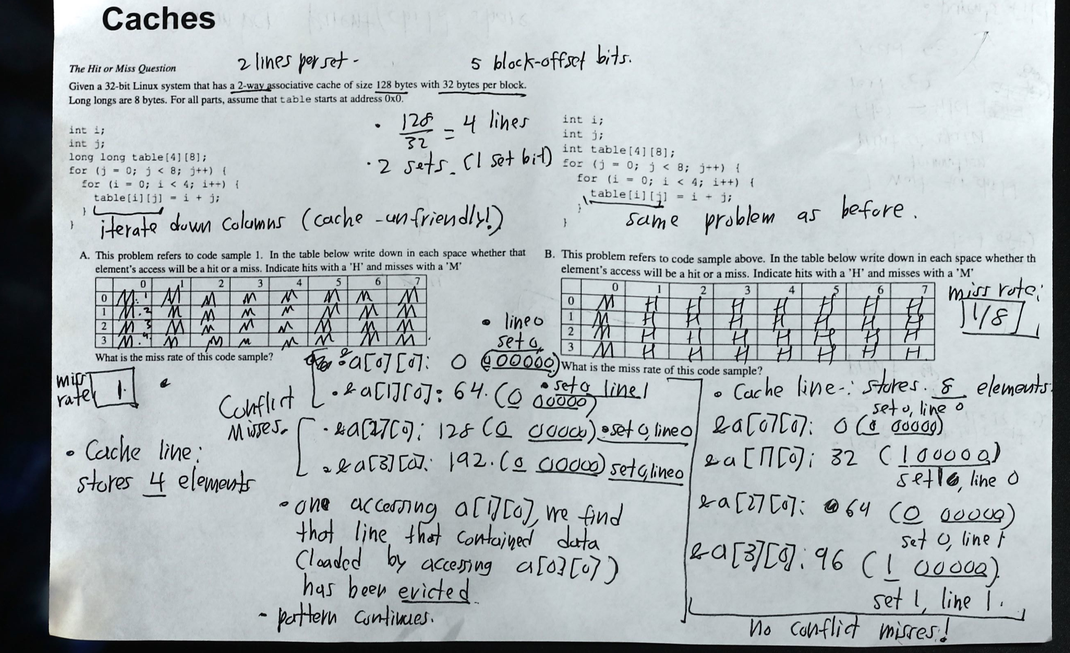

Slide 53
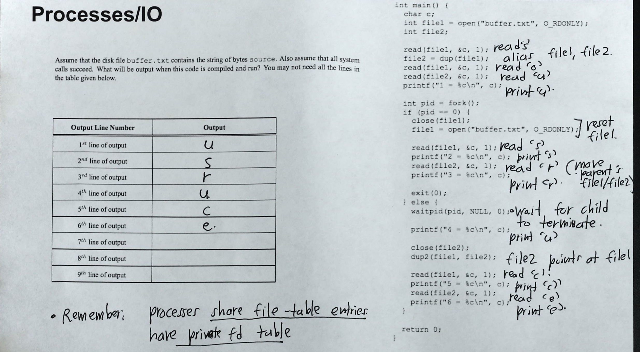

Slide 54
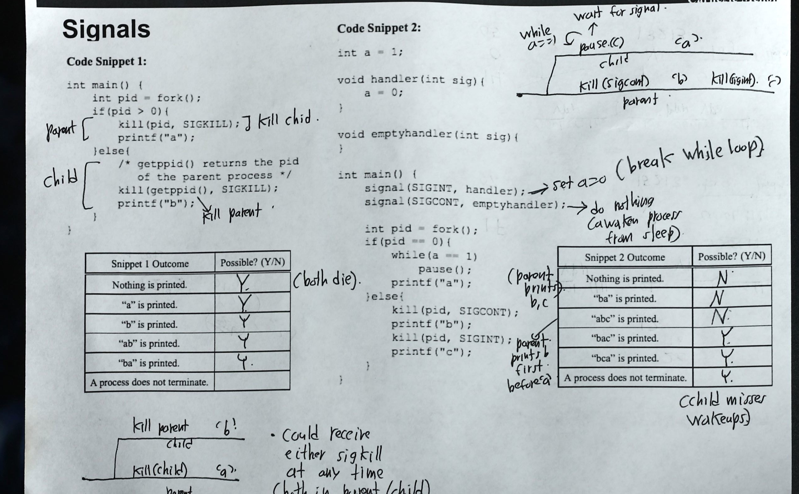

Slide 55
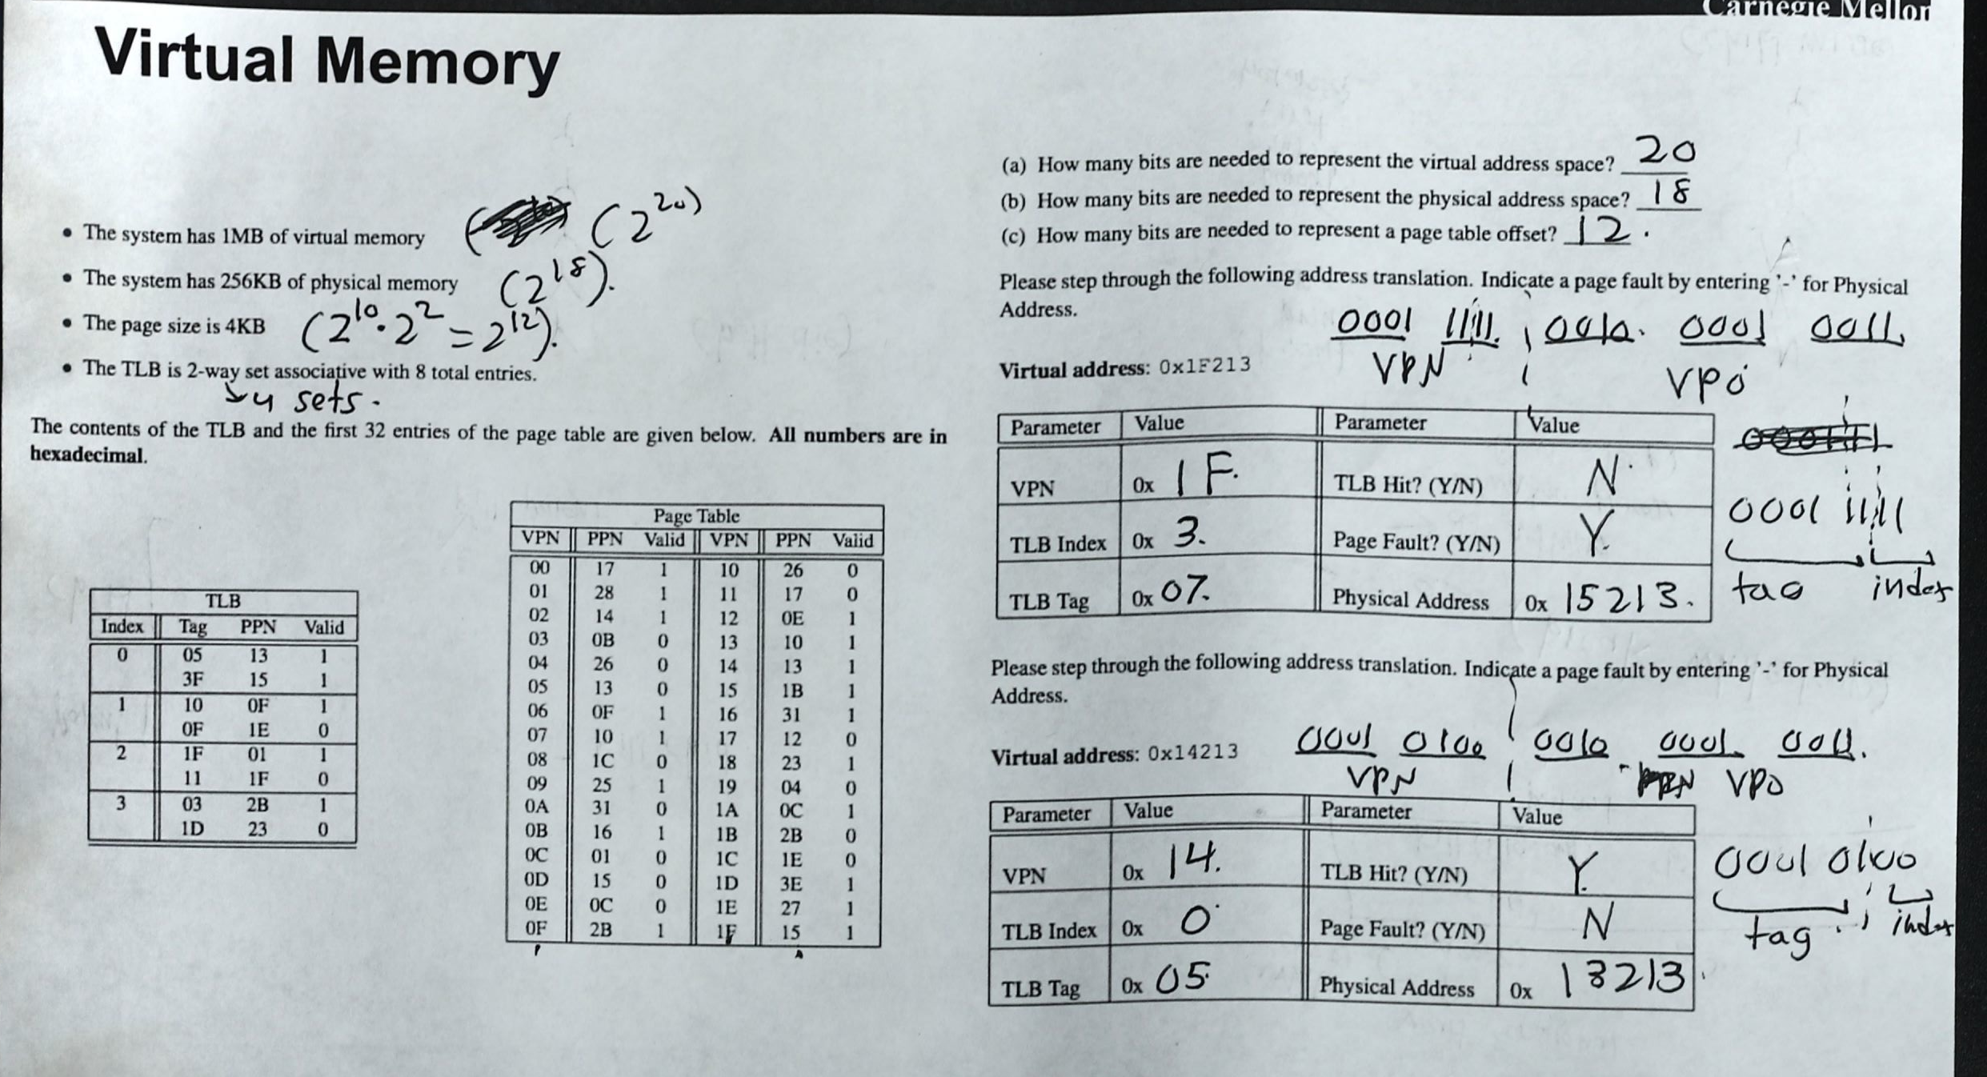

Slide 56
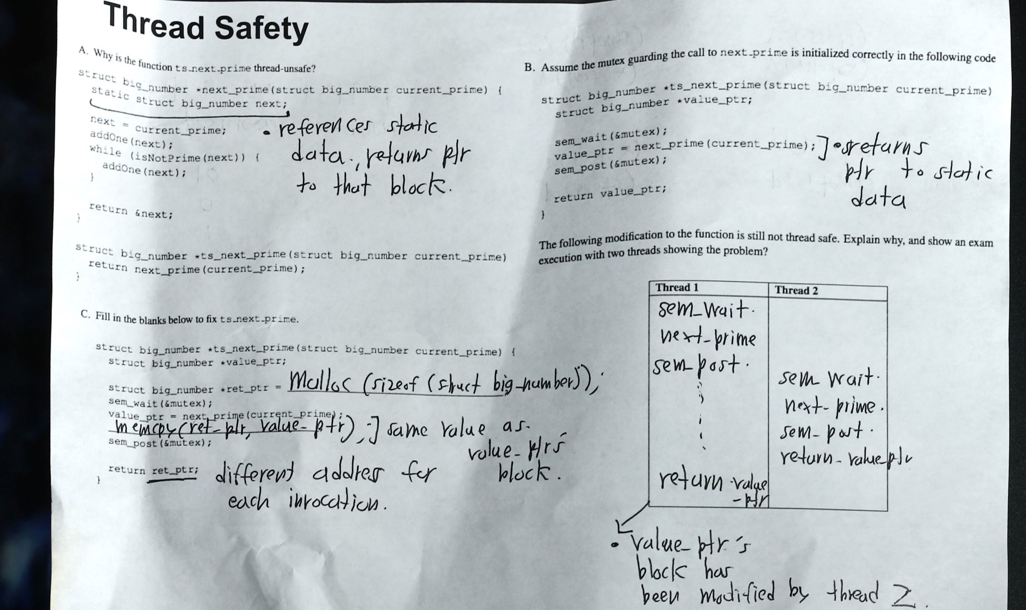

Slide 57
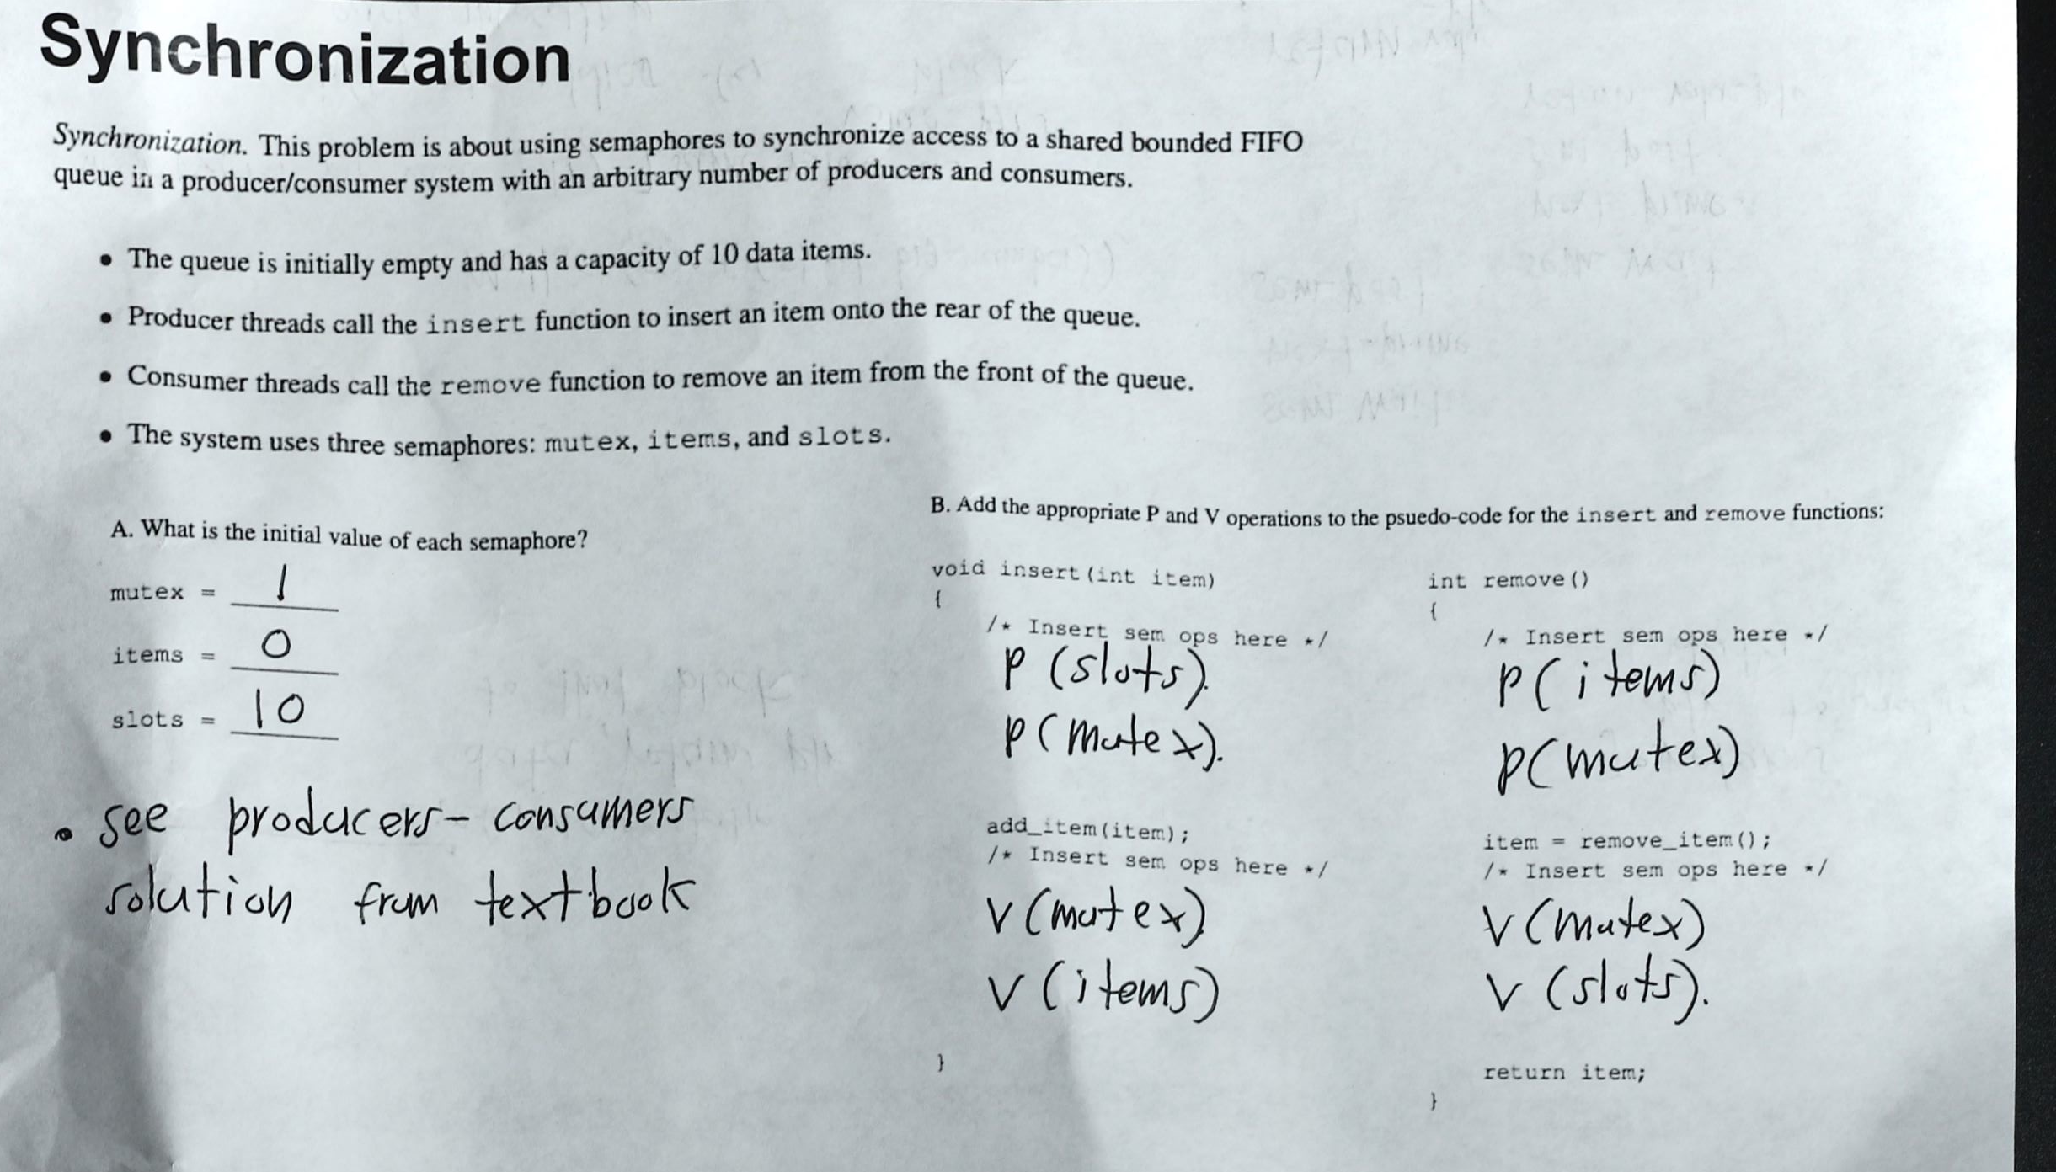

Slide 58

Questions?
All the Best!

